Slide 1


Slide 2
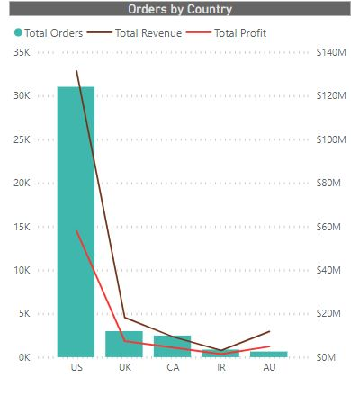
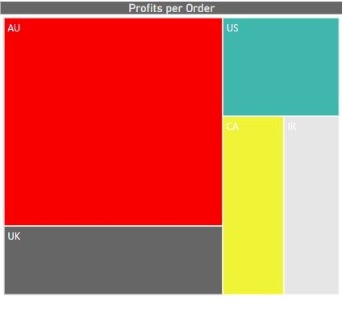
Summary: Top 10 Insights
Surprisingly ‘AU’ beats ‘US’ in terms of “Profit per Order” (Profit/Order), while ‘US’ still beats everyone in terms of ‘Total Orders placed’, ‘Total Revenue’ and ‘Total Profit’ generated.
“Profit/Order” shows
effective profit (avg)
gained by company
on every order placed.
This shows ‘AU’
customers are most
profitable.

Slide 3

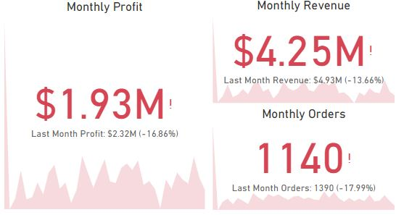
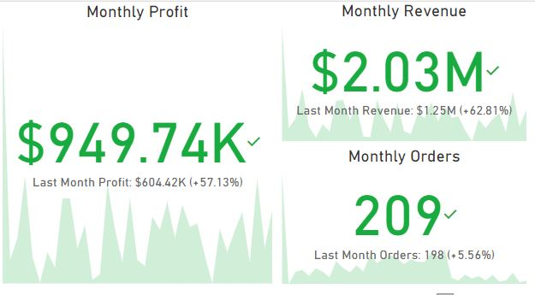
Company performance in last month looks critical. Order count, Revenue and Profit generated falls significantly. All the regions shows the same trend, while surprisingly ‘Central’ region shows significant increase in ‘Profit’ and ‘Revenue’.
Company performance ‘Central’ region performance

Slide 4

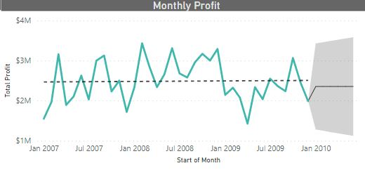
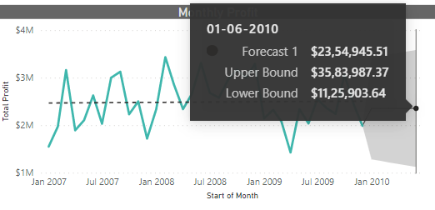
On the basis of current and past performance of the company, the range of “Monthly Profit” of the company will lie in range $11,25,903.64 - $35,83,987.37 with a confidence of 95%

Slide 5

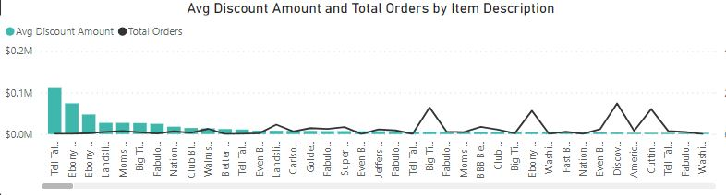
Negative Co-relation is found between ‘Average Discount Amount’ and ‘Total Orders by Item Description’. This is weird, as more the discount, more the sale (usually this is seen).

Slide 6

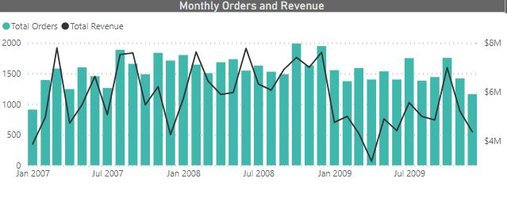
Least ‘Revenue’ is generated in the month of April 2009, and the revenue was falling down from past 4 months, although a sharp increase in ‘Revenue’ is seen in later few months.

Slide 7

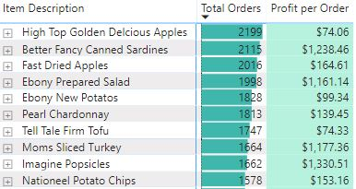
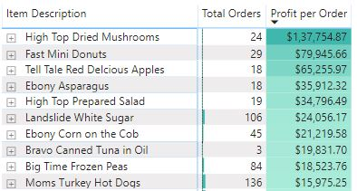
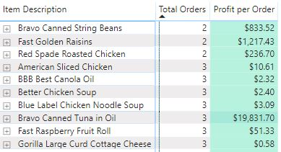
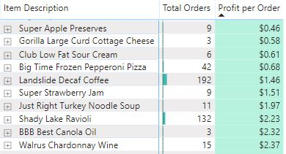
Top 10 items in terms of ‘Most Ordered’ and ‘Least Ordered are as shown (the 2 left figures), while Top 10 items in terms of ‘Maximum Profit per Order’ and ‘Least Profit Per Order’ are also shown below.

Slide 8

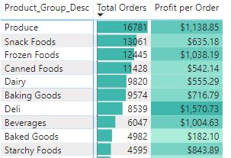
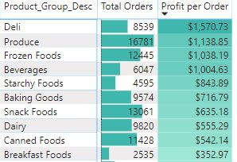
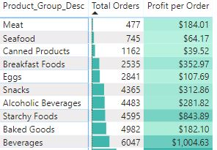
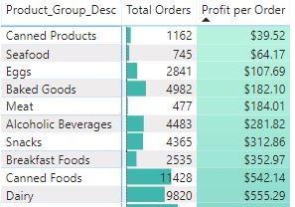
Top 10 ‘Product Group’ in terms of ‘Most Ordered’ and ‘Least Ordered are as shown (the 2 left figures), while Top 10 ‘Product Group’ in terms of ‘Maximum Profit per Order’ and ‘Least Profit Per Order’ are also shown below.

Slide 9

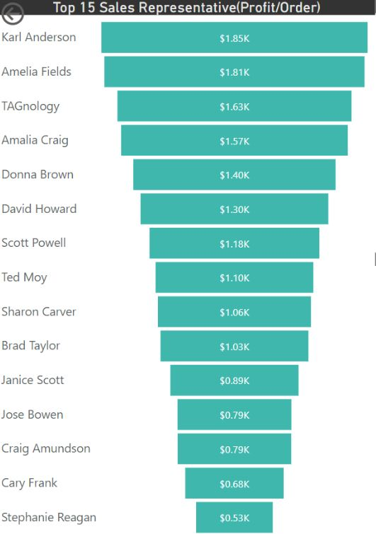
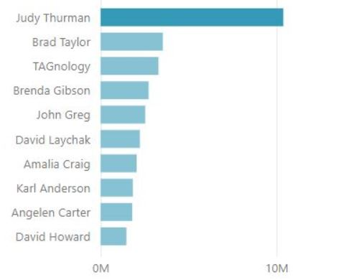
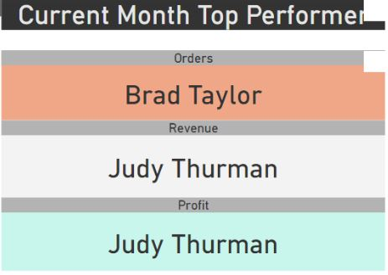
‘Top Performers’ as ‘Sales Representative’, in
terms of ‘Profit gained / Order placed’ are
shown. Below figure shows ‘Monthly Best
Performers in ‘Sales’, ‘Revenue’ and ‘Orders’.
‘Judy Thurman’ has noticeably more ‘YTD
Revenue’ as shown.

Slide 10

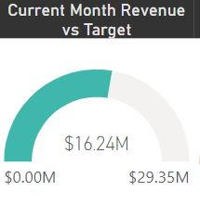
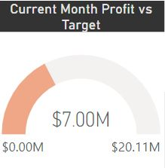
‘Monthly Revenue’ generated is equal to $16.24 M while ‘Target Revenue’ is equal to $29.35 M.
‘Monthly Profit’ generated is equal to $7 M while ‘Target Profit’ is equal to $20.11 M.

Slide 11

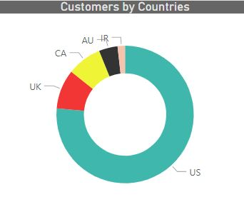
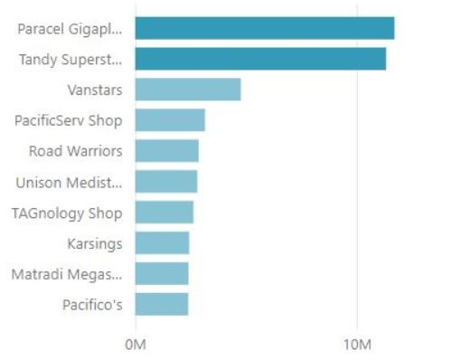
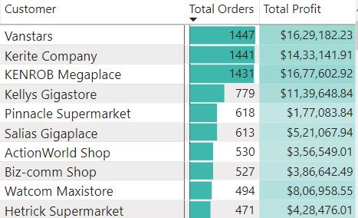
‘US’ comprise of ~75% of total customers, followed by ‘UK’.
Top 10 customers are shown as well.
Important insight :- Top 3 customers orders ~9% of total orders placed.
‘Paracel Gigaplace’ and ‘Tandy Superstore’ have high ‘Budget Sum’.

Slide 12
Anything Else ?
Our experience till now at ‘Data Fiesta 2.0’ had been amazing. Learned a lot, and looking forward to continue. Hackathons brings people together, and this is what makes it ‘worth to participate’.

